Slide 1
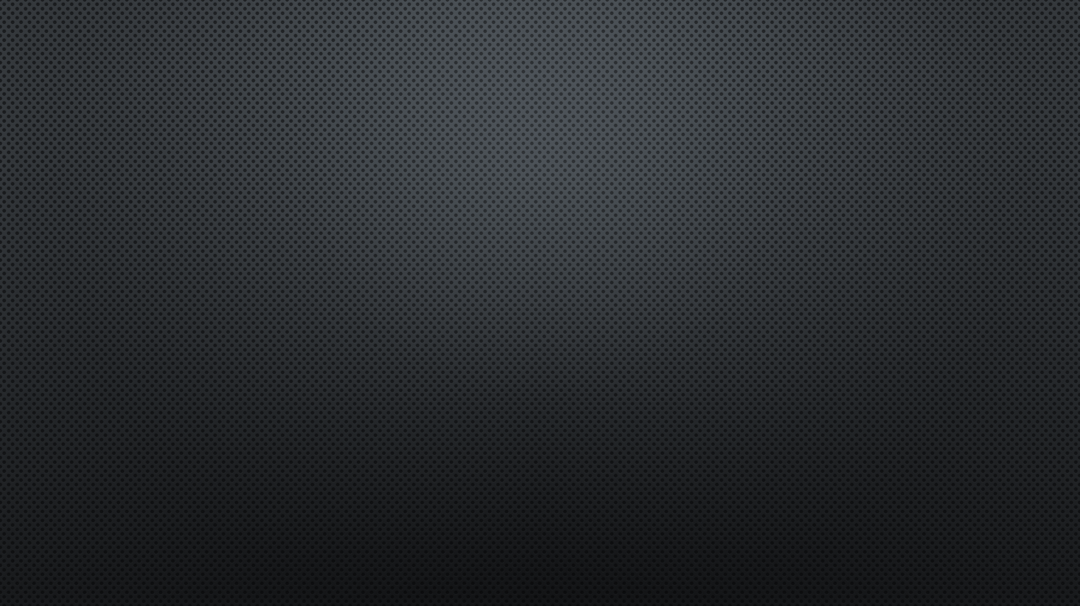
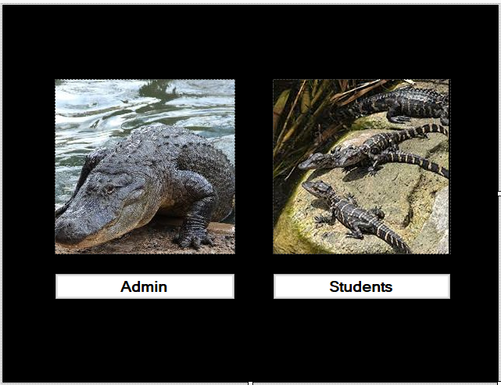
BLACKBOARD
by: Earnest Teamer, Andrew Nguyen, Daniyal Raoofi, Hassan Alsalman, Keaton Alexander

Slide 2
TEAM INFO
Team Model: Democratic
Tools Used: Discord, GroupMe , Trello, SQL Server Management Studio, Lucid Chart, GitHub, Visual Studio , .NET Framework C# , Google Documents, Gmail, Google.com, MS Office Suite, TeamViewer
Andrew and Earnest: Design Implementation ( Programming )
Hassan and Keaton: Documentation
Daniyal : UML Diagram, Use-Case & PowerPoint
https://github.com/A-TNguyen/BlackBoard_Application

Slide 3
Analysis
The client’s requirement is to develop a learning management system (LMS) to help a university IT department with their activities and improve their services,
Management is able to track student’s basic information.
The product is supposed to simulated a typical LMS, which includes Blackboard or Moodle.
The specifications of this project includes:
Design A Graphical User Interface
Link the GUI to a database that holds all the information regarding academic records.
Add use cases for both students and teachers with each to have a specific user view.
The student would be able to enroll in classes, and view their grades, and view their GPA according to their grades.
Teachers are referred to as Admin in our software, and they’re able to insert, update, and monitor the whole process.
The students can log in via a username and password, and they can only view their information and not able to perform changes.

Slide 4
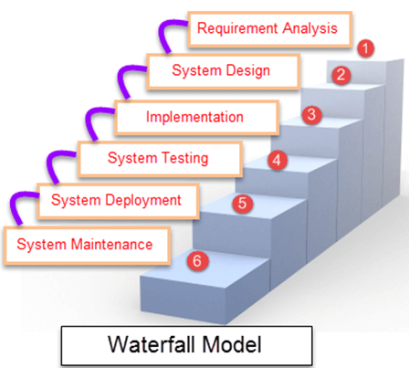
System Development Life Cycle
Different phases | Activities performed in each stage
Requirement Gathering stage | We gathered the requirements from the project description posted on bb.uhd.edu for Software Engineering Class.
Design Stage | We decided to use two programming languages to create the software, then decide which application is more efficient: First choice was using Visual Basics programming language in parallel with Microsoft Access as a database. Second choice was using C# in .NET framework, in parallel with MySQL.
Built Stage | At this Stage, we started coding the program, by dividing the work among team members.
Test Stage | In this phase, you test the software to verify that it is built as per the specifications given by the Professor Chang.
Deployment stage | Deploy the project in the built environment, by presenting it to class on Monday 11/25/2019.
Maintenance stage | At this point, the software is complete, and we regulate maintenance period or apply changes per client’s request.

Slide 5
Use-Case(viewing student info/Login)
Use case name: View student records/info
Actor/User: Admin, Student
Steps:
User clicks on “student” or “admin”
User enter’s “student Username” and “Password” or if admin: User enter “admin Username” and “Password”
if user enter wrong psw or user it will be incorrect
User clicks “login button”
Once logged on:
User views “grades”
User views “Courses”
User views “GPA”
User views “name & ID”
User can click “logout” to exit

Slide 6
Use-Case(entering a new Student)
Use case name: Entering a new Student
Actor/User: Admin
Steps:
User clicks on “View Student” button.
System displays an entry screen with new user id generated and prompts the user to enter first name,
last name, Student ID, Courses, Grades and calculate the GPA.
User clicks on “Add New Student” button.
System creates new student record in the database.
User can use “logout” to exit

Slide 7
Use-Case(Update Existing Students)
Use case name: Updating an existing student
Actor/User: admin
Steps:
User clicks on “Student number” button.
System displays the students information screen and prompts the user to input the updated information
Once updated the system allows the User to save by clicking “Save Student Data” button
User has the option to update other students as well by their enrollment number.
User can use “logout” to exit

Slide 8
Use-Case(Delete Existing Student)
Use case name: Deleting an existing student
Actor/User: admin
Steps:
User enter on the “enrollment #” to choose the targeted student .
User selects “ Delete Student Data” to delete the student.
System asks User if he is sure, User can select “yes”
Student is deleted from the database.
User can use “logout” to exit

Slide 9
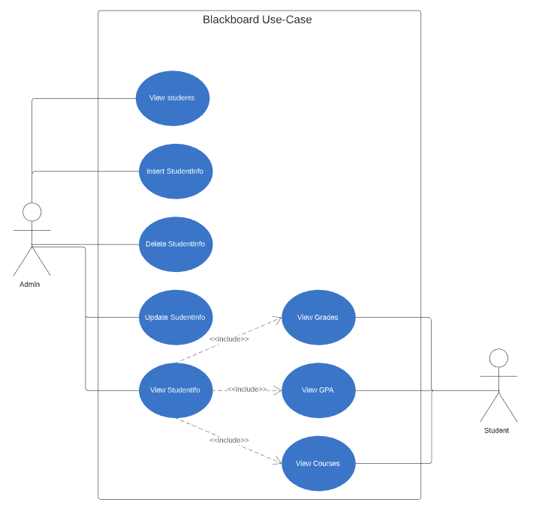
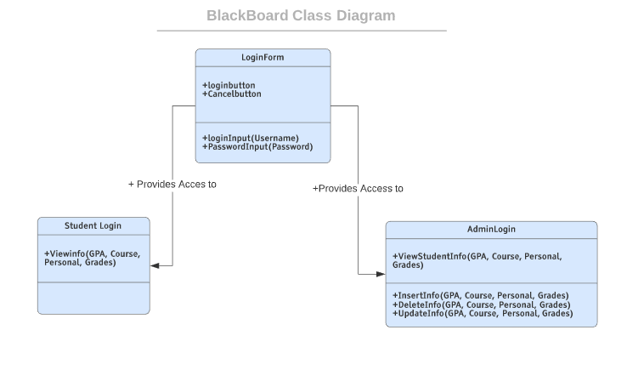
UML DIAGRAM’S

Slide 10
1.1 Analysis
The client’s requirement is to develop a learning management system (LMS) to help a university IT department with their activities and improve their services, and for the management to track student’s basic information.
The product is supposed to simulated a Typical LMS, which includes Blackboard or Moodle. Our project is done by a team of 5 undergraduate students during an academic semester, in conjunction with lectures and other class activities. It is similar to Blackboard or Moodle LMS system.
The specifications of this project includes:
Designa Graphical User Interface
Link the GUI to a database that holds all the information regarding academic records.
Add use cases for both students and teachers with each to have a specific user view.
The student would be able to enroll in classes, and view their grades, and view their GPA according to their grades.
Teachers are referred to as Admin in our software, and they’re able to insert, update, and monitor the whole process.
The students can log in via a username and password, and they can only view their information and not able to perform changes.

Slide 12
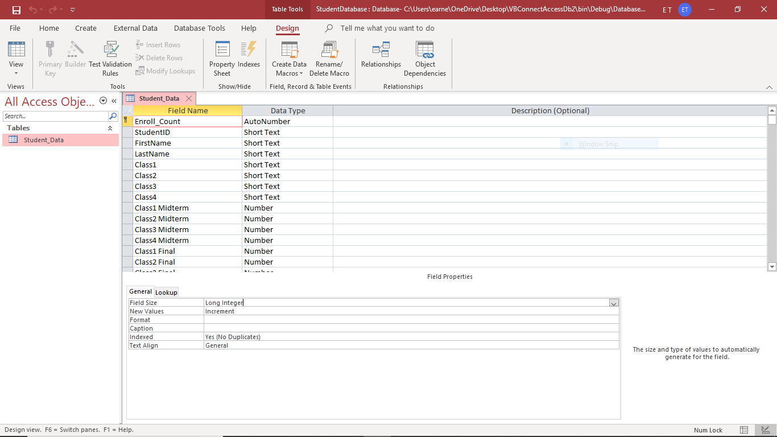
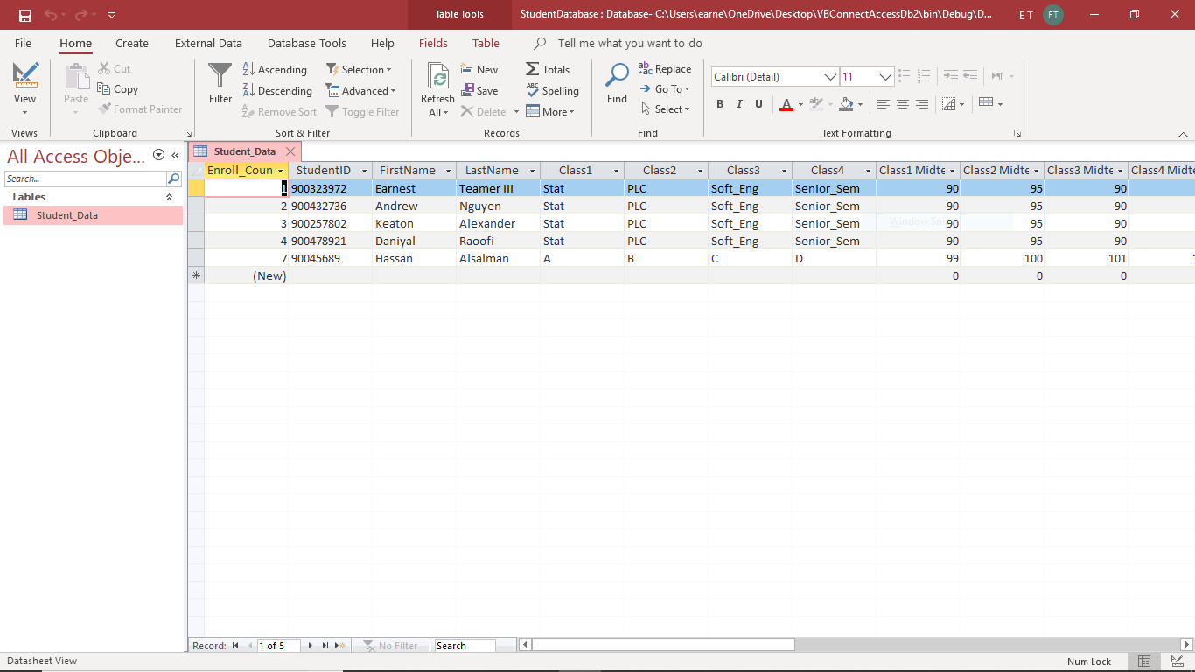
DATABASE
Database where students are kept after being added to blackboard by the admin
Can also be removed when deleted from the blackboard

Slide 13
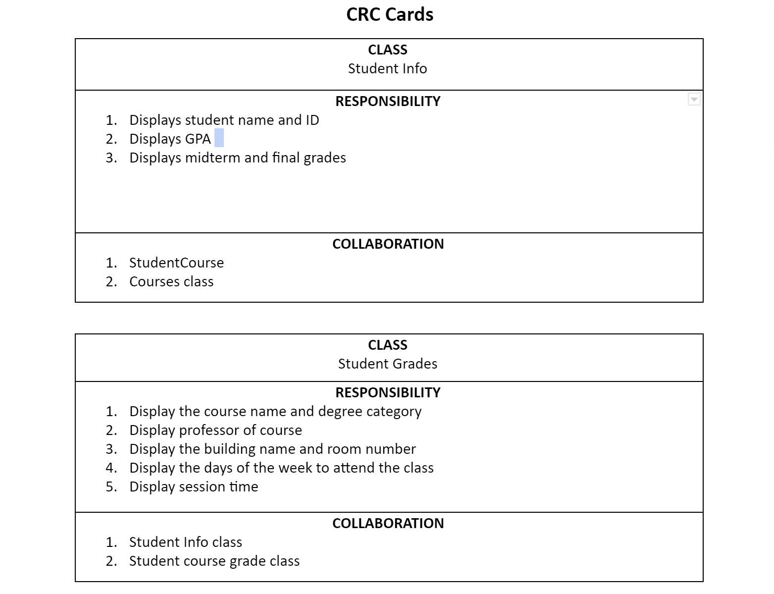

Slide 14
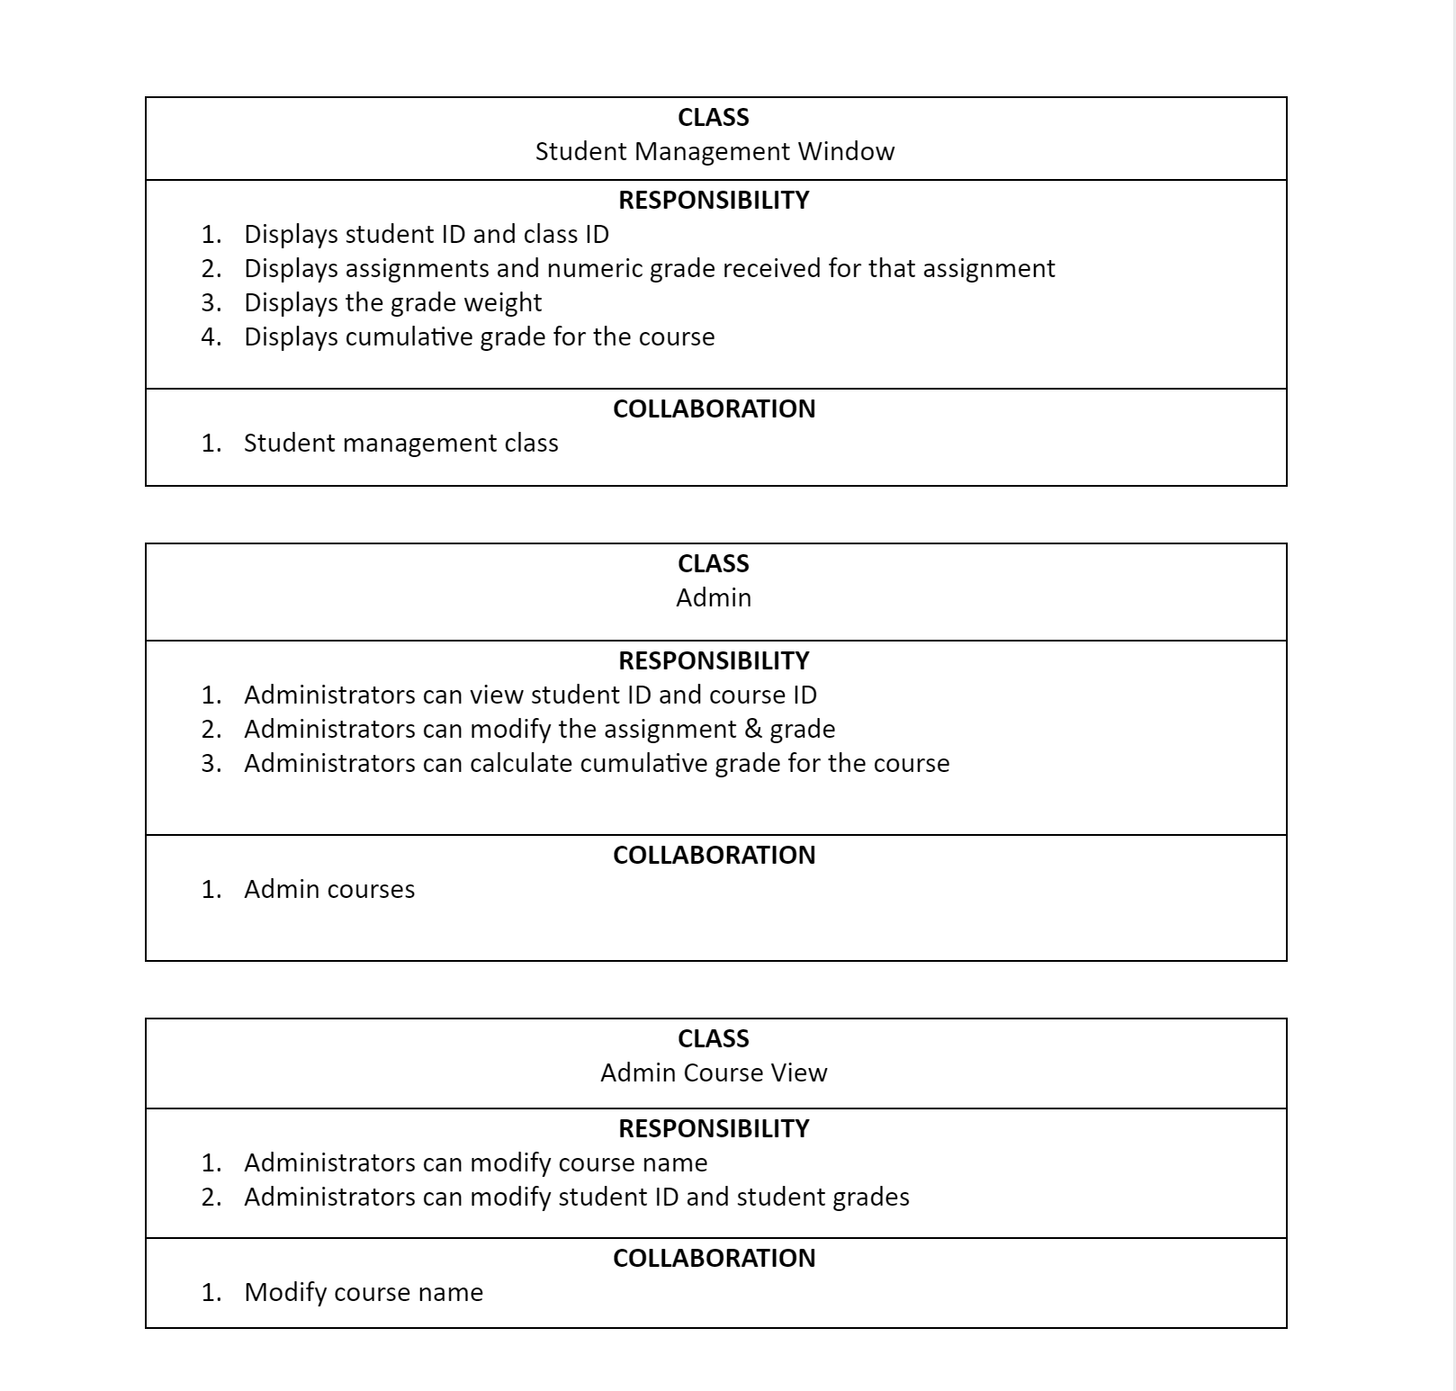

Slide 15
LOGIN PAGE
Login button(admin): will give you access to the Administrative side of blackboard
Login button(Student): will give access to normal student side of blackboard

Slide 16
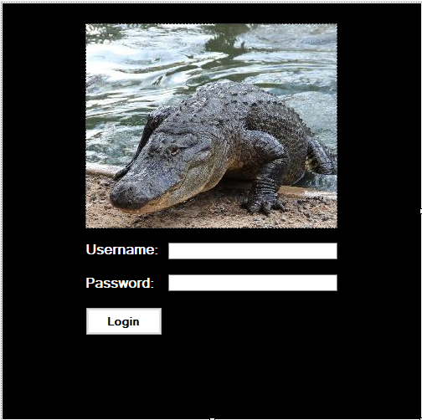
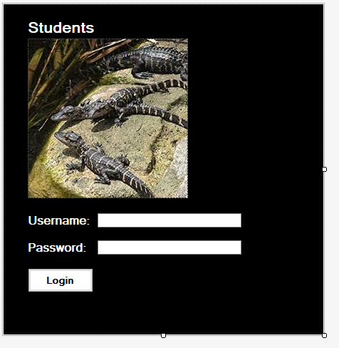
STUDENT AND ADMIN LOGIN SECTION
Enter admin username
Enter admin password
Login button gives access to administrator with correct login details
Enter student username
Enter student password
Login button gives access to students account with correct login details

Slide 17
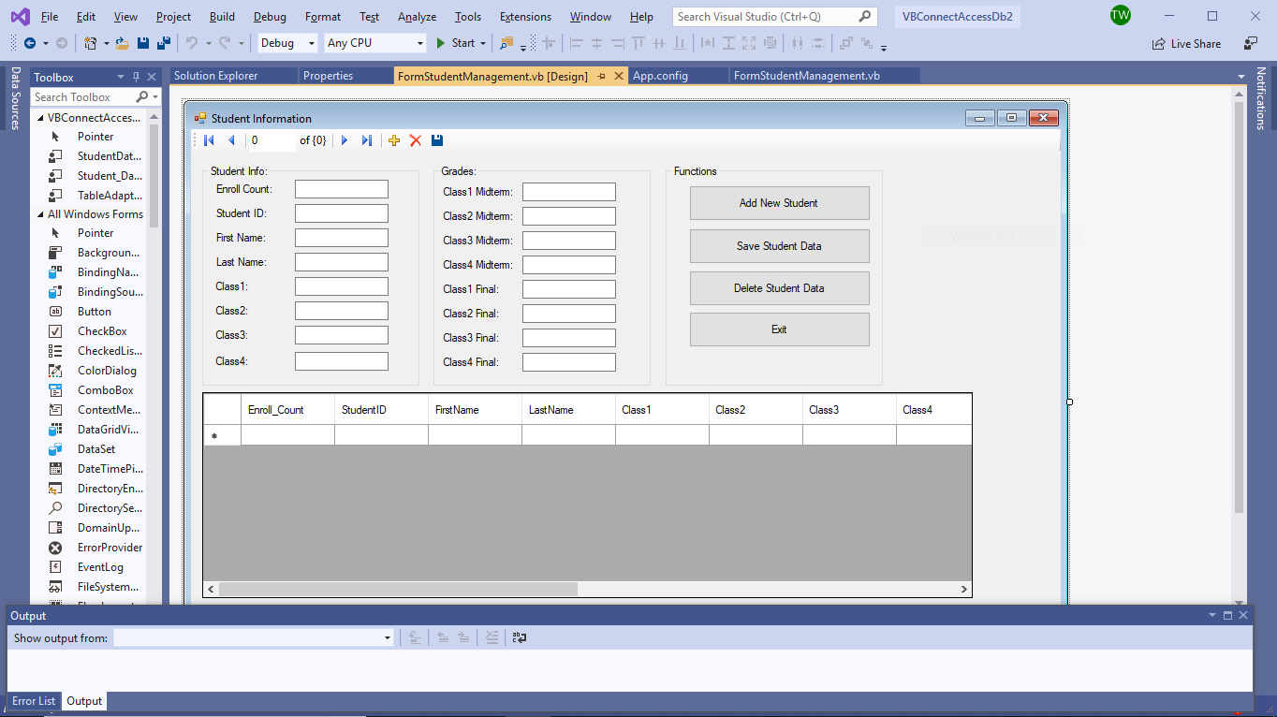
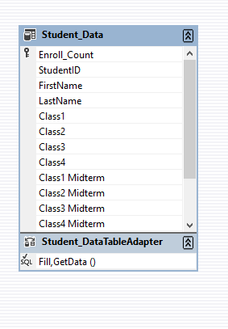
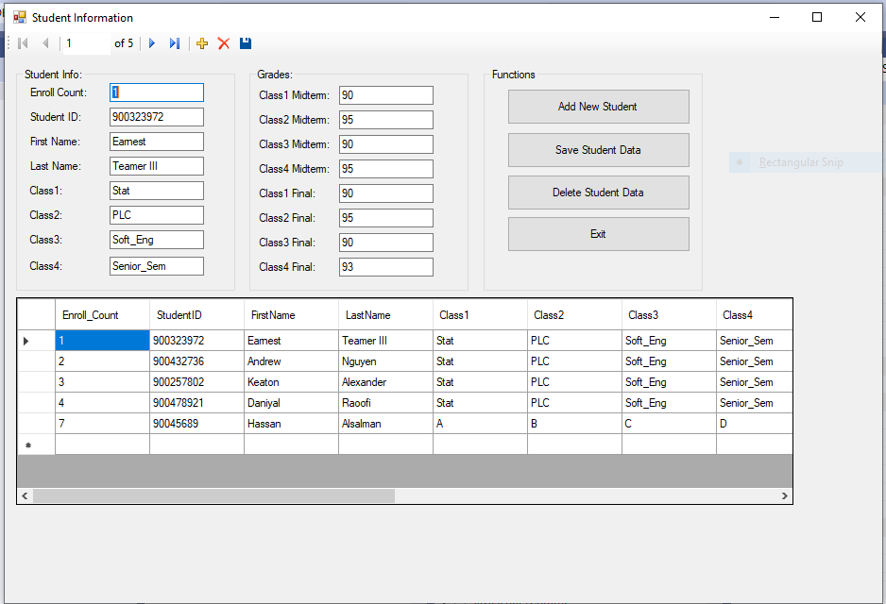
ADDING/DELETING/UPDATING A STUDENT
Add new student button will add a new student after his information has been added to the system
Save student data will update an already added student on the system
Deleting student data will remove the student from the blackboard.
Exit will logout from the blackboard

Slide 18
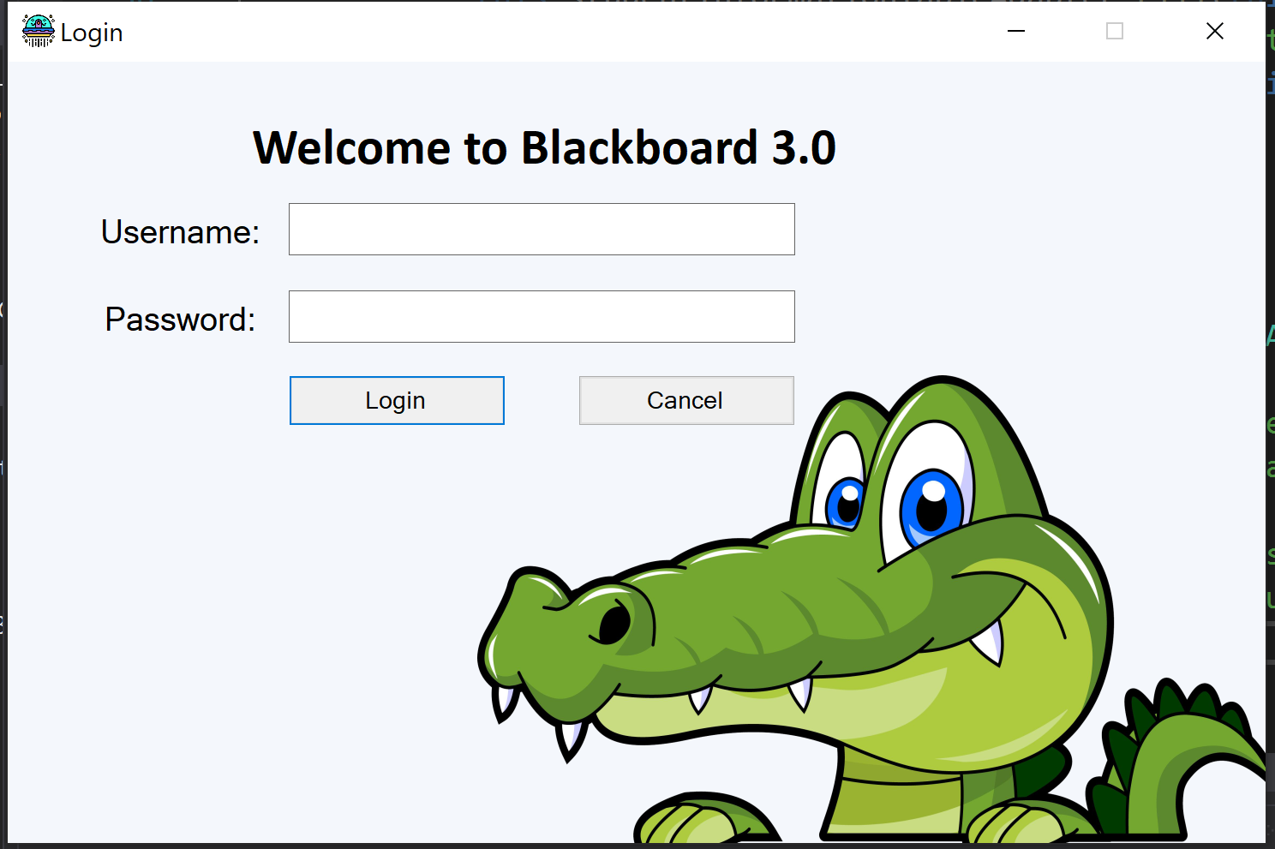
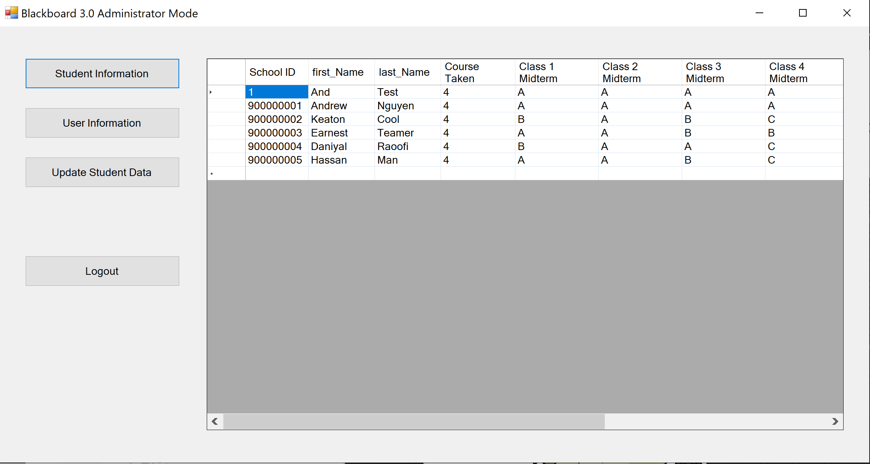
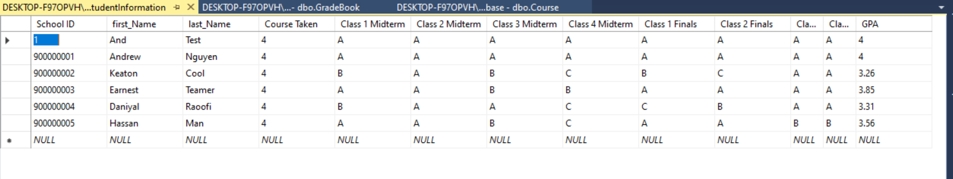
FAILED PROJECTS: C# https://github.com/A-TNguyen/BlackBoard_Application

